Slide 1
Nexthikes IT Solutions
Feature Extraction and Price Prediction for Mobile Phones
PRESENTED BY VIKAS KUMAR

Slide 2
agenda
Mobile Phone Price Prediction
Machine Learning Project

Slide 3
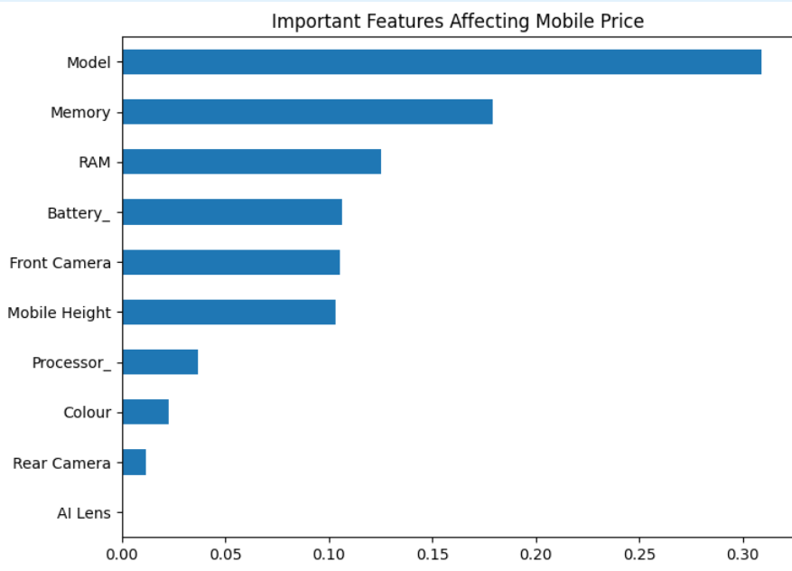
• Analyze factors influencing mobile phone prices • Identify the most important features affecting price • Build machine learning models to predict mobile phone prices • Provide insights for pricing and marketing strategies
Project Objective

Slide 4
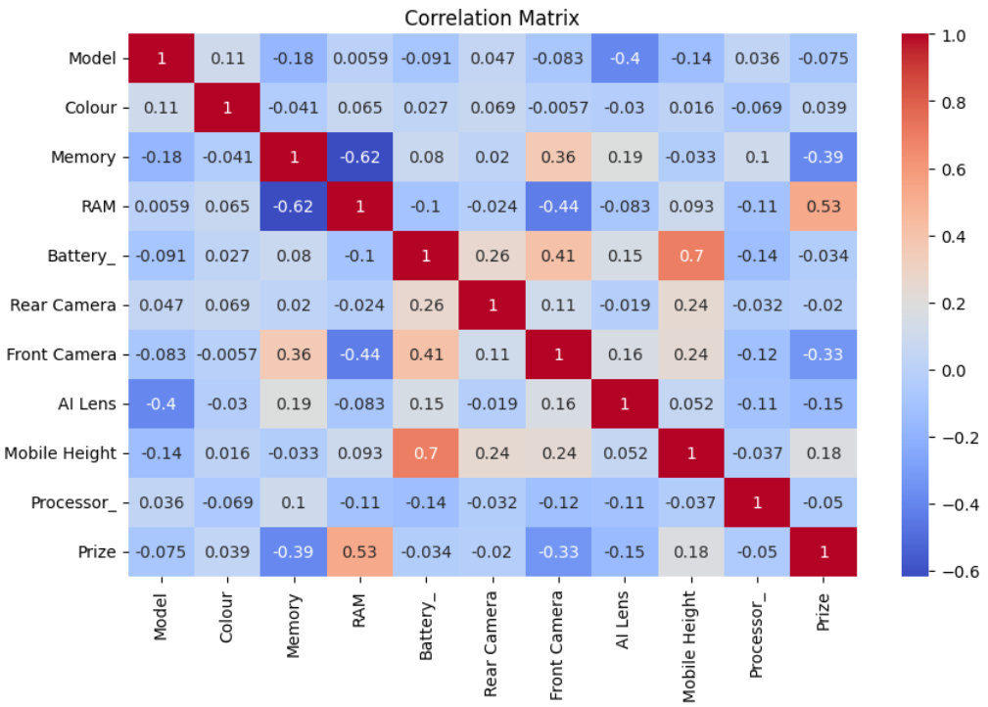
Dataset Overview
Dataset includes features such as:
• Model
• Colour
• Memory
• RAM
• Battery Capacity
• Rear Camera
• Front Camera
• Processor

Slide 5
Data Exploration (EDA)
Steps performed:
• Loaded dataset using Pandas
• Checked missing values and data types
• Generated descriptive statistics
• Visualized relationships between features and price
• Correlation heatmap analysis

Slide 6
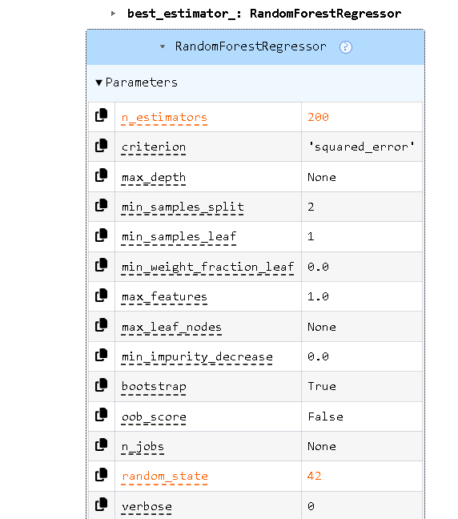
Feature Extraction
Techniques used:
• Correlation Analysis
• SelectKBest feature selection
• Random Forest feature importance
Key extracted features:
• RAM
• Memory
• Processor
• Rear Camera
• Battery Capacity

Slide 7
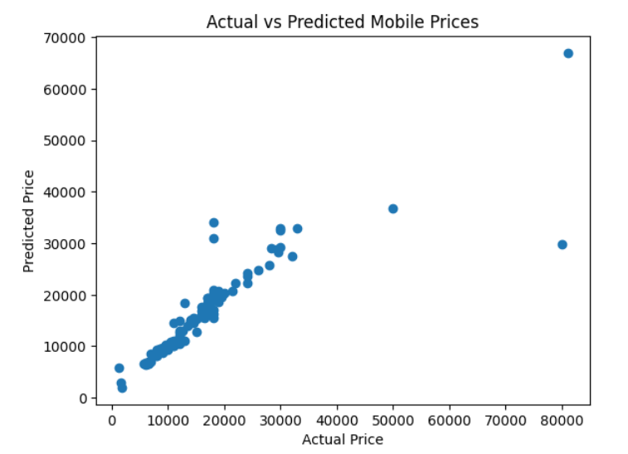
Model Building
Dataset split:
• 80% Training Data
• 20% Testing Data
Models used:
• Linear Regression
• Decision Tree
• Random Forest

Slide 8
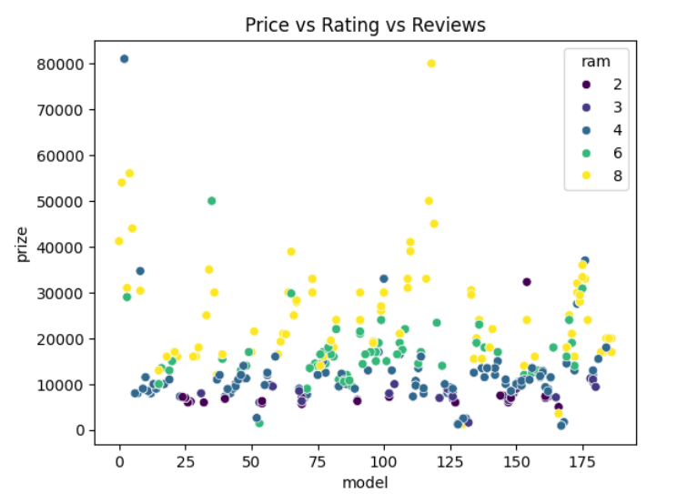
Model Evaluation
Evaluation Metrics:
• Mean Absolute Error (MAE)
• Root Mean Squared Error (RMSE)
• R² Score
Random Forest produced the best prediction accuracy.
Know your material in advance
Anticipate common questions
Rehearse your responses

Slide 9
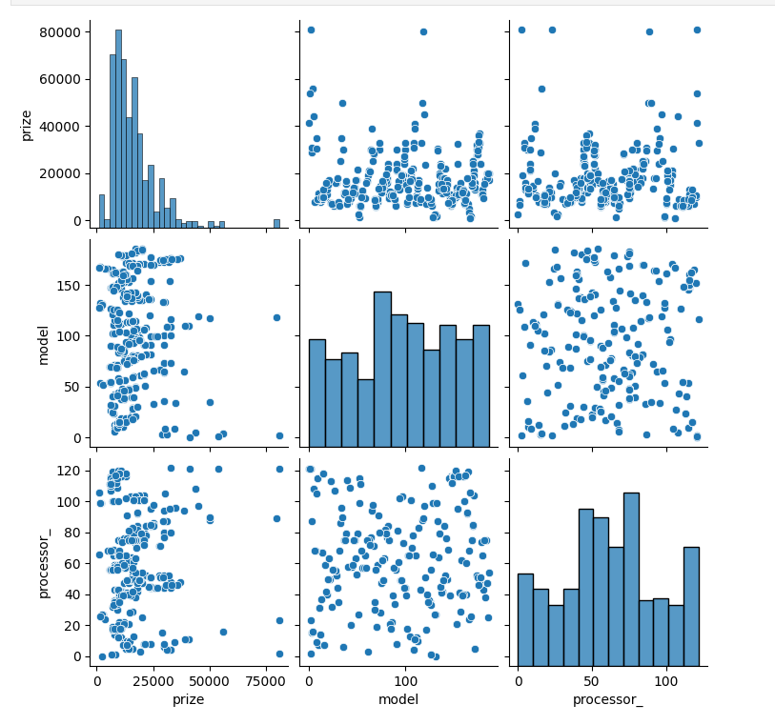
Feature Importance Analysis
Most influential features affecting price:
• RAM
• Internal Memory
• Processor
• Rear Camera
• Battery Capacity
These features strongly impact mobile phone pricing.

Slide 10
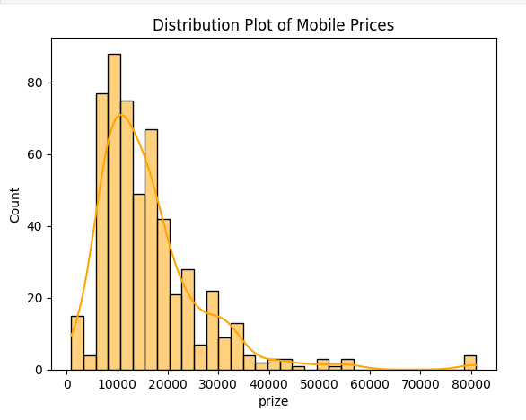
Recommendations
• Focus on increasing RAM and storage in premium models
• Invest in better processors for performance-based pricing
• Improve camera technology for high-end devices
• Use machine learning models to estimate competitive prices

Slide 11
Conclusion
• Machine learning successfully predicted mobile phone prices
• Random Forest model performed best
• Key features affecting price were identified
• Model can help organizations make data-driven pricing decisions

Slide 12
Thank You

